Slide 1
Naïve Bayesian Classifier
Swarna Chaudhary
Assistant Professor
swarna.chaudhary@pilani.bits-pilani.ac.in

Slide 2

The slides presented here are obtained from the authors of the books and from various other contributors. I hereby acknowledge all the contributors for their material and inputs.
I have added and modified a few slides to suit the requirements of the course.

Slide 3
In this segment
Probability Basics
Bayes Theorem
Naïve Bayesian Classifier
An illustrative Example
Naïve Bayes Classifier is a generative model
Advantages of Naïve Bayes Classifier and when to use Naïve Bayes Classifier?
Interpretability of Naïve Bayes Classifier
Python Implementation

Slide 4

Probability basics
Random Experiment
A random experiment is an experiment or a process for which the outcome cannot be predicted with certainty
Example:
Tossing a coin
number of calls to a communication system during a fixed length interval of time
Rolling a die
Sample Space:
The sample space of a random experiment is the set of all possible outcomes. Denoted by omega Ω/S
Example:

Slide 5
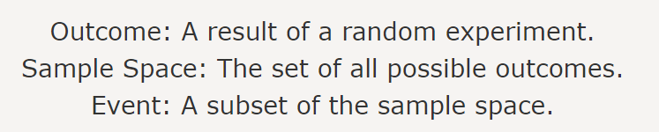
Probability basics…contd
Events
Events are the subsets of the sample space
Simple Events: If an event consists of only one outcome, it is a simple event
Union and Intersection: If A and B are events, then A∪B and A∩B are also events.
Examples:
A= {the outcome that the dice is even} = {2,4,6}
B= {at least 2 tails}

Slide 6
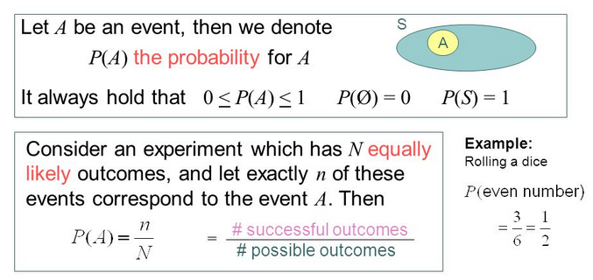
Probability
Question: You roll a fair die. What is the probability of E={1,5}?

Slide 7
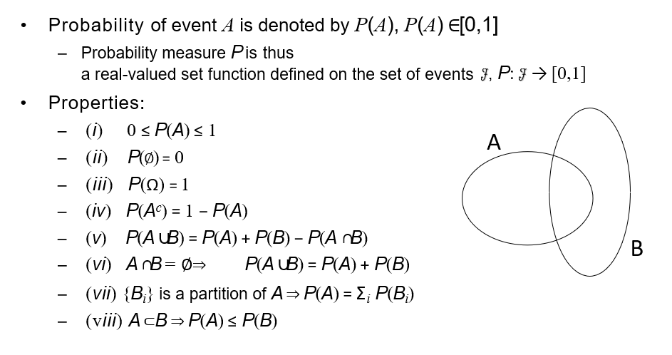
Probability -Axioms

Slide 8
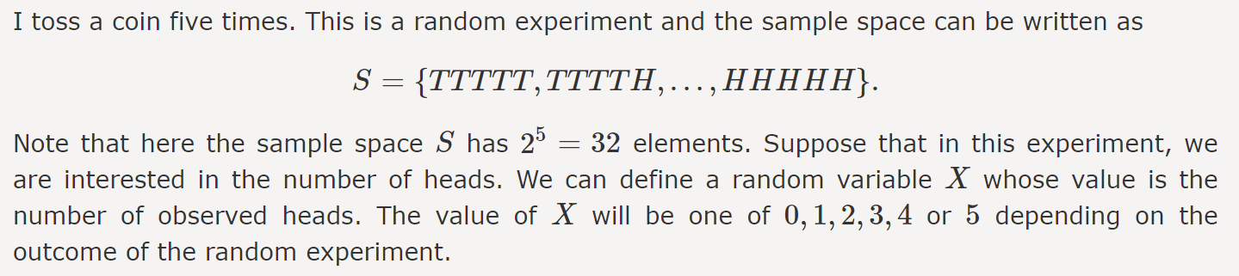
Random Variables
A random variable, is a variable whose possible values are numerical outcomes of a random experiment.
Random variable X is a function from the sample space to the real numbers.
Denoted by Capital letter

Slide 9
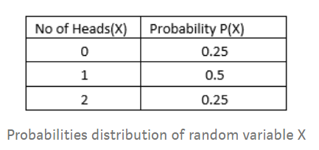
Random Variables
1. Discrete Random Variable is one which may take on only a countable number of distinct values such as 0,1,2,3,4
X = sum of values on the roll of two dice,
X has to be either 2, 3, 4, …, or 12.
X be the number of heads that result from the toss of 2 coins.
Here X can take values 0,1, or 2. X is a discrete random variable.
2. Continuous Random Variable Continuous Data can take any value within a range.
Example, List all the real numbers between [0,1]

Slide 10
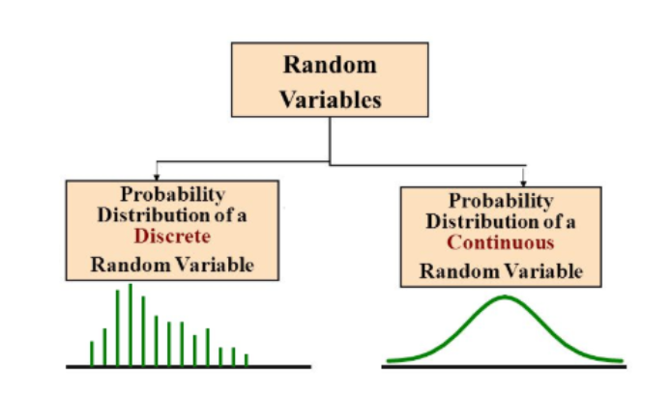
Random Variables

Slide 11
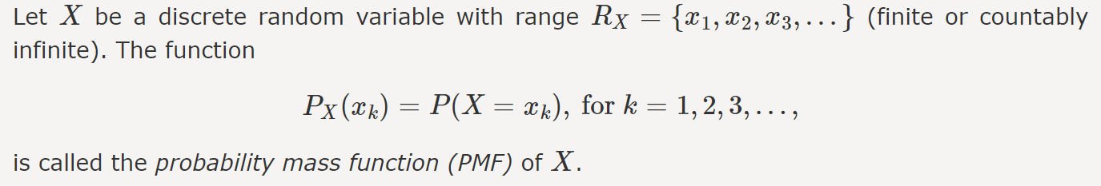
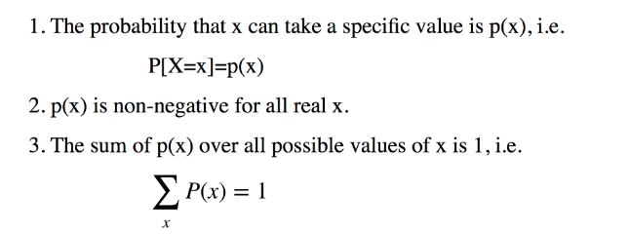
Probability Distribution of Discrete Random Variable
Discrete Probability Distribution: The mathematical definition of a discrete probability function, p(x), is a function that satisfies the following properties. This is referred as Probability Mass Function.
Probability mass function (pmf): P(X=x_{i})
Simple facts about pmf

Slide 12
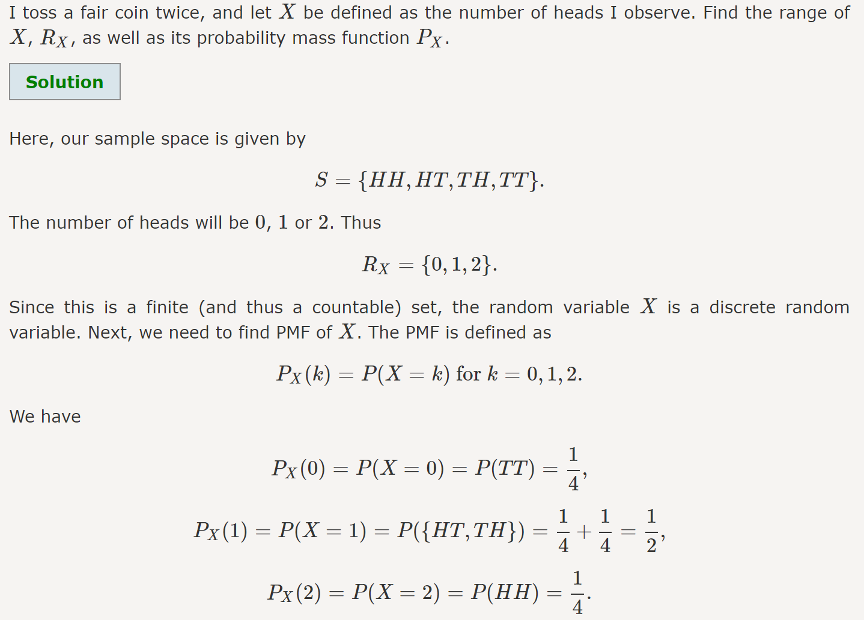
Example

Slide 13
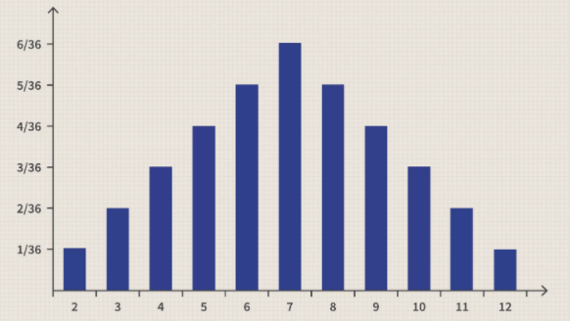
Probability Distribution - Example
Sum of 2 dice

Slide 14
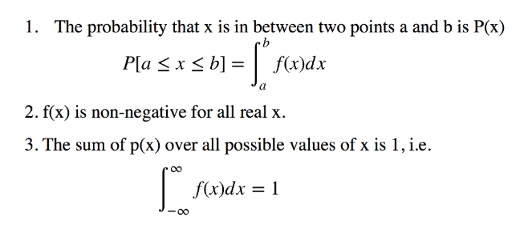
Probability of Continuous Random Variable
Continuous Probability Distribution: The mathematical definition of a continuous probability function, f(x), is a function that satisfies the following properties. This is referred as Probability Density Function.
Simple facts about pdf

Slide 15
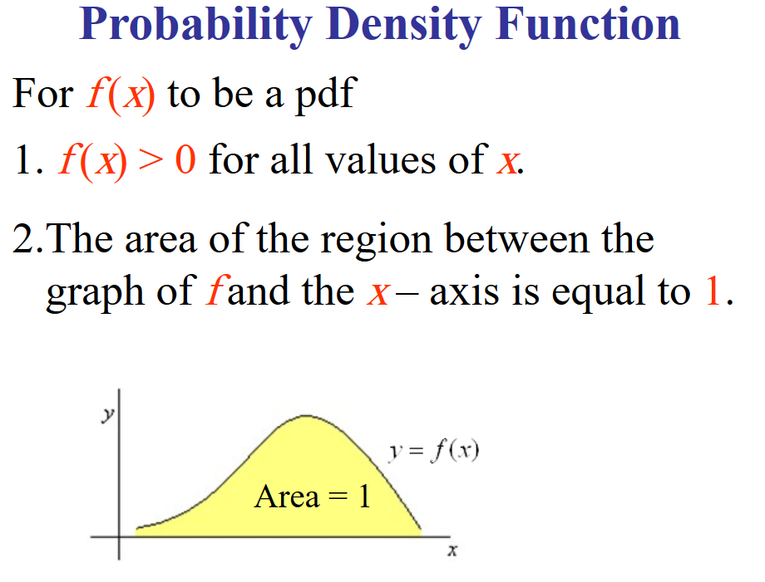
Probability Density Function

Slide 16
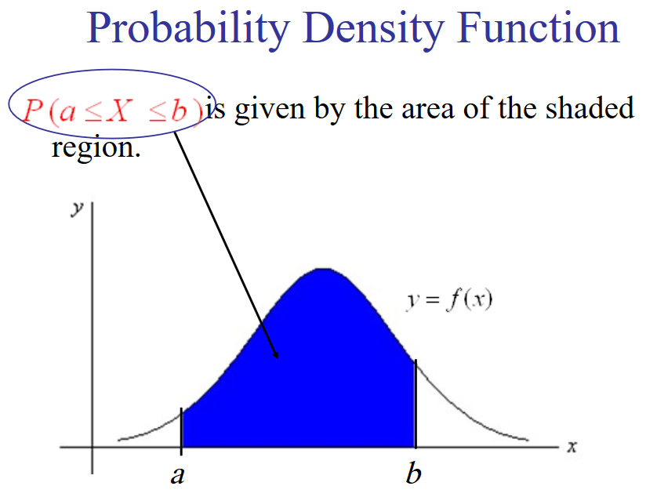
Probability Density Function

Slide 17
Gaussian Distribution
The normal curve is bell-shaped and has a single peak at the
exact center of the distribution.
The arithmetic mean, median, and mode of the distribution are equal and located at the peak.
Half the area under the curve is above the peak, and the other half is below it.
The normal distribution is symmetrical about its mean.
The normal distribution is asymptotic - the curve gets closer and closer to the x-axis but never actually touches it.

Slide 18
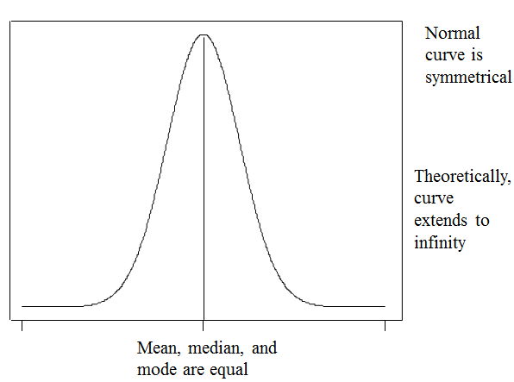
Gaussian Distribution

Slide 19
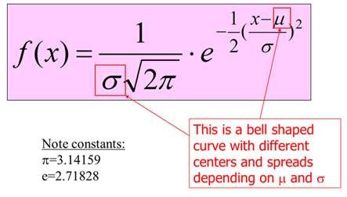
MATHEMATICAL FUNCTION (pdf)

Slide 20
Gaussian Distribution- Parameter
The normal distribution can be completely specified by two
parameters:
Mean
Standard deviation

Slide 21
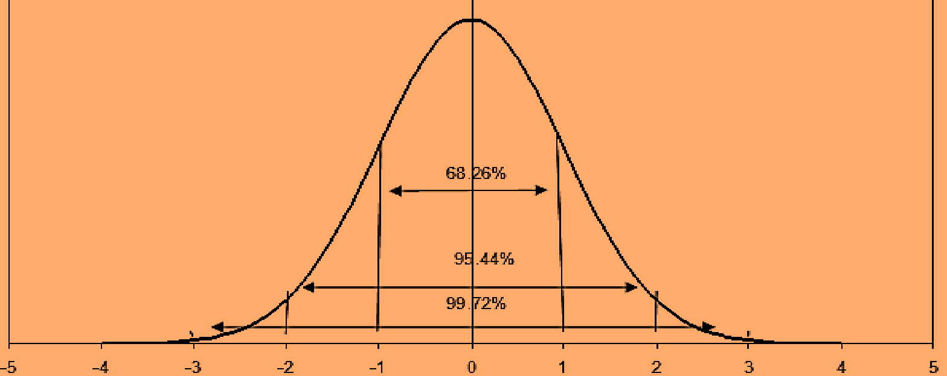
Properties of normal curve
No matter what the value of µ and σ are, area under normal curve remain in certain fixed proportions within a specified number of standard deviation on either side of µ. For example the interval
µ ± σ will always contain 68.26%
µ ± 2σ will always contain 95.44%
µ ± 3σ will always contain 99.73%

Slide 22
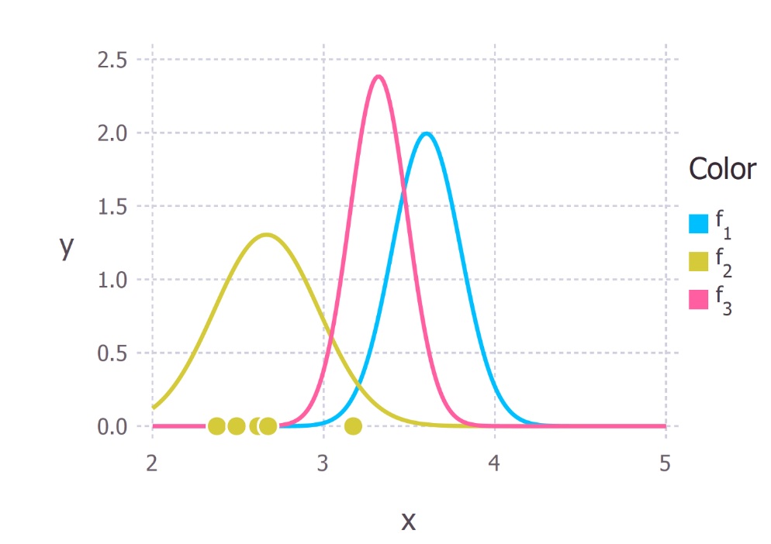
Gaussian Distribution

Slide 23
Joint Probability
Joint probability is the probability of two events happening together. The two events are usually designated event A and event B. In probability terminology, it can be written as:
P(X and Y) or P(A n B) or P(X,Y)
Example: The probability that a card is a five and black, p(five and black) = 2/52 = 1/26, (There are two black fives in a deck of 52 cards, the five of spades and the five of clubs)

Slide 24
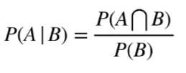
Conditional Probability
Conditional Probability is a measure of the probability of an event given that (by assumption, presumption, assertion or evidence) another event has already occurred. If the event of interest is A and the event B is known or assumed to have occurred.
This probability is written P(A|B), notation for the probability of A given B.
Example: Let a pair of dice is thrown. If the sum of the numbers on the dice is 7, Find the probability that at least one of the dice shows 2.

Slide 25
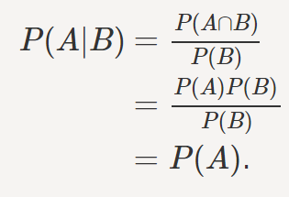
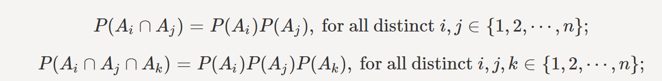
Independence
Two events A and B are independent if and only if P(A∩B)=P(A)P(B).
if two events A and B are independent and P(B)≠0, then P(A|B)=P(A).
In general, for n events A1,A2,⋯,An to be independent we must have
Example: If a dice is thrown twice, What is the probability that the first throw results in a number greater than 4 and the second throw results in a number less than 3.

Slide 26
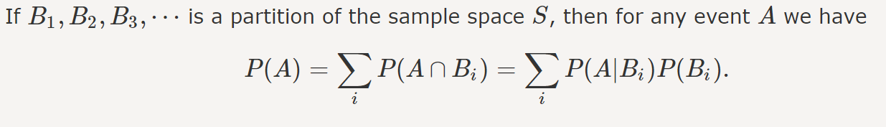
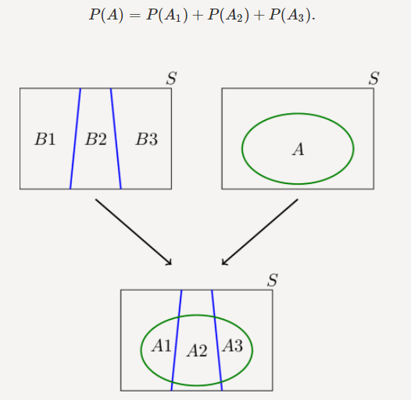
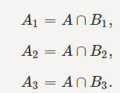
Law of Total Probability

Slide 27
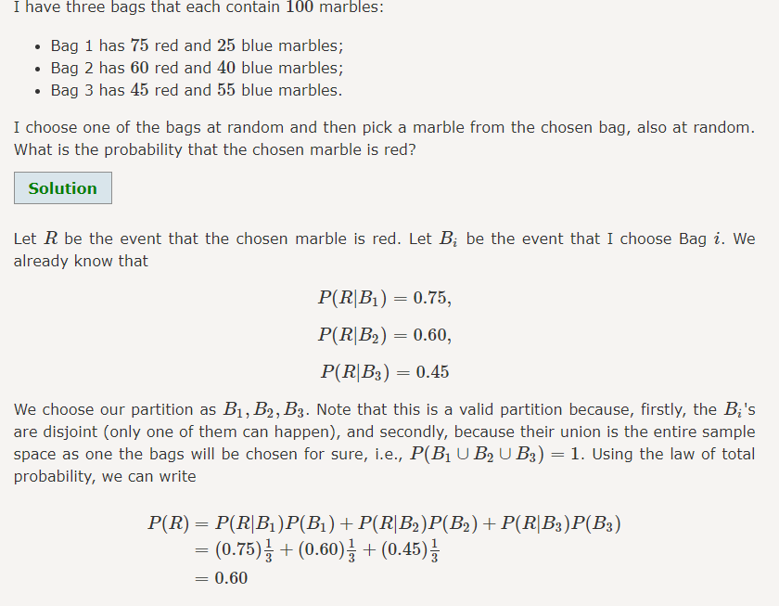
Law of Total Probability

Slide 28
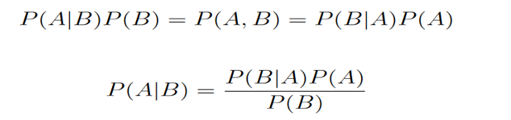
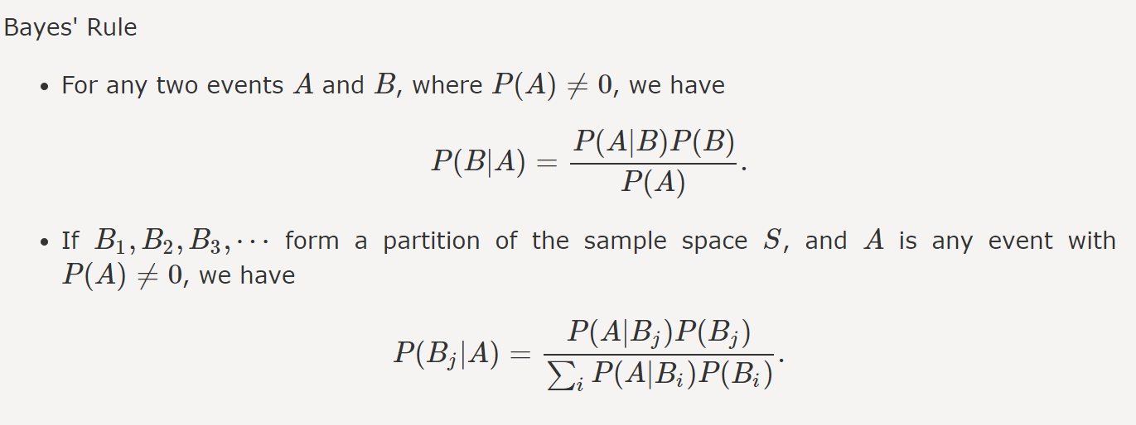
Bayes Rule
From the definition of conditional distribution

Slide 29
Example of Bayes Theorem
Suppose the fraction of undergraduate students who play sport is 15% and the fraction of graduate students who play sports is 23%. If one-fifth of the college students are graduate students and the rest are undergraduates, what is the probability that a student who plays a sport is a graduate student?

Slide 30
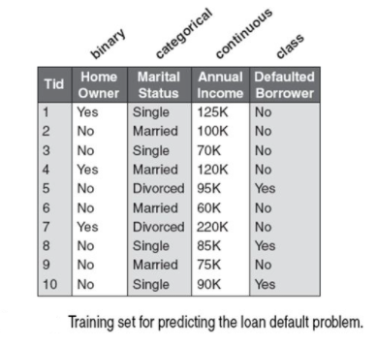
Example of Bayes Theorem
Classify the record:
X = (Home Owner = No, Marital Status = “Married”, Annual Income = $120k)

Slide 31
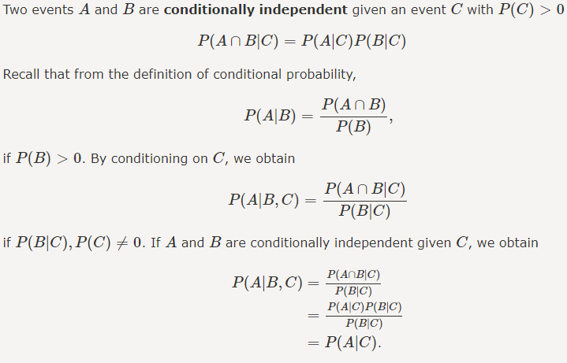

Conditional independence

Slide 32
Bayesian Classifiers
Let the attributes X₁, X₂,…,X_{n} and class labels Y_{1,} Y_{2,}..Y_{m} be random variables
Given a record with attributes (X₁, X₂,…,X_{n})
Goal is to predict class Y=Y_{k}
We want to find the value of Y that maximizes P(Y| X₁, X₂,..,X_{n})
Can we estimate P(Y| X₁, X₂,..,X_{n}) directly from data?

Slide 33
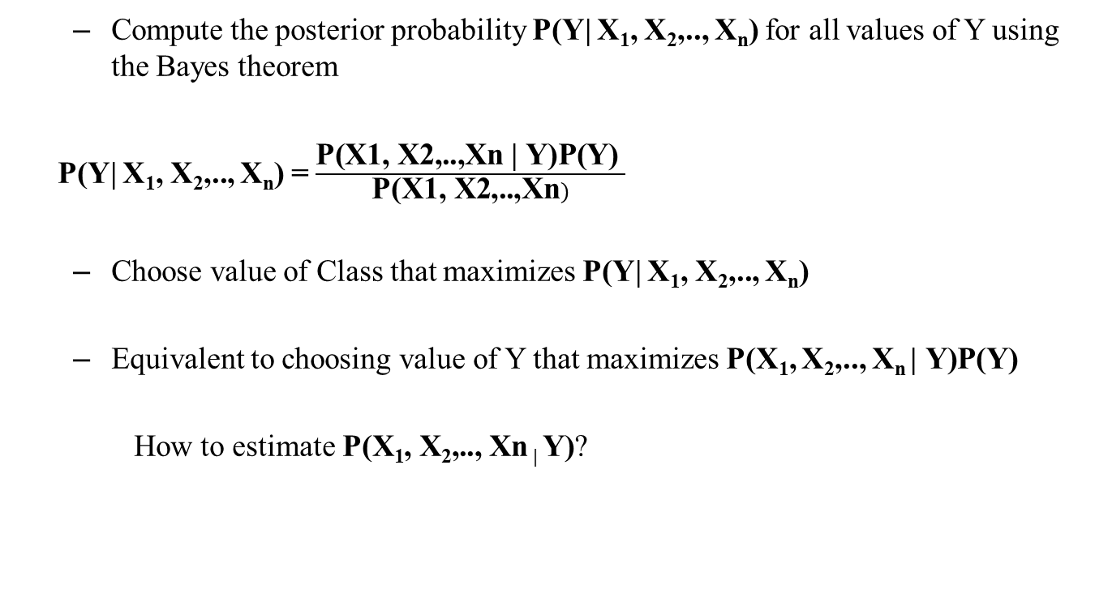
Bayesian Classifiers
Compute the posterior probability P(Y| X₁, X₂,.., X_{n}) for all values of Y using the Bayes theorem
P(Y| X₁, X₂,.., X_{n}) = $\frac{\text{P}\text{(}\text{X}\text{1, }\text{X}\text{2,..,}\text{Xn}\text{ | }\text{Y}\text{)}\text{P}\text{(}\text{Y}\text{) }}{\text{P}\text{(}\text{X}\text{1, }\text{X}\text{2,..,}\text{Xn})}$
Choose value of Class that maximizes P(Y| X₁, X₂,.., X_{n})
Equivalent to choosing value of Y that maximizes P(X₁, X₂,.., X_{n} $\text{| }\text{Y}\text{)}\text{P}\text{(}\text{Y}\text{) }$
How to estimate$\text{P}\text{(}\text{X}\text{1}\text{, }\text{X}\text{2}\text{,.., }\text{Xn}\text{ | }\text{Y}\text{)}$?

Slide 34

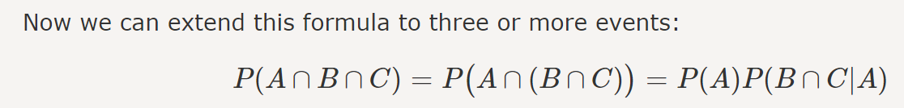
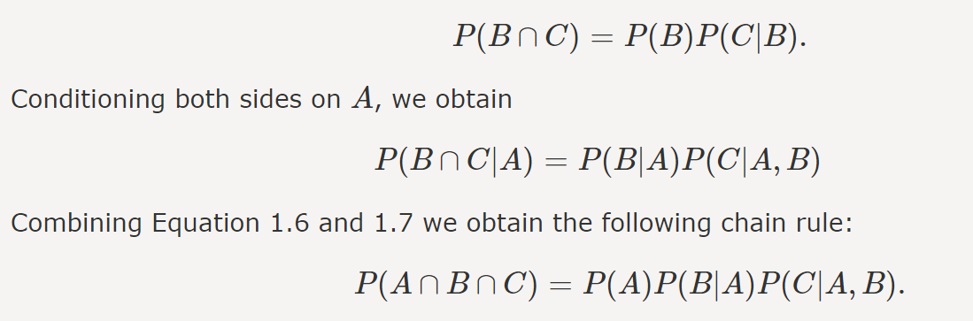
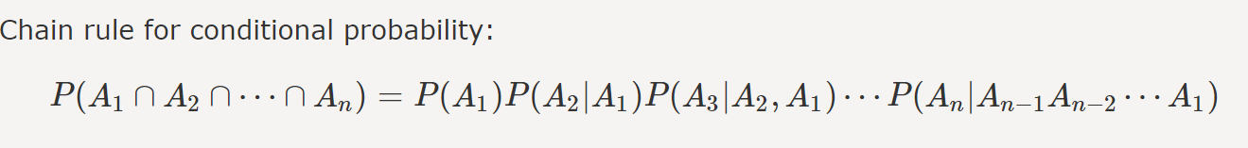
Chain Rule for Conditional Probability
https://www.probabilitycourse.com/chapter1/1_4_0_conditional_probability.php

Slide 35
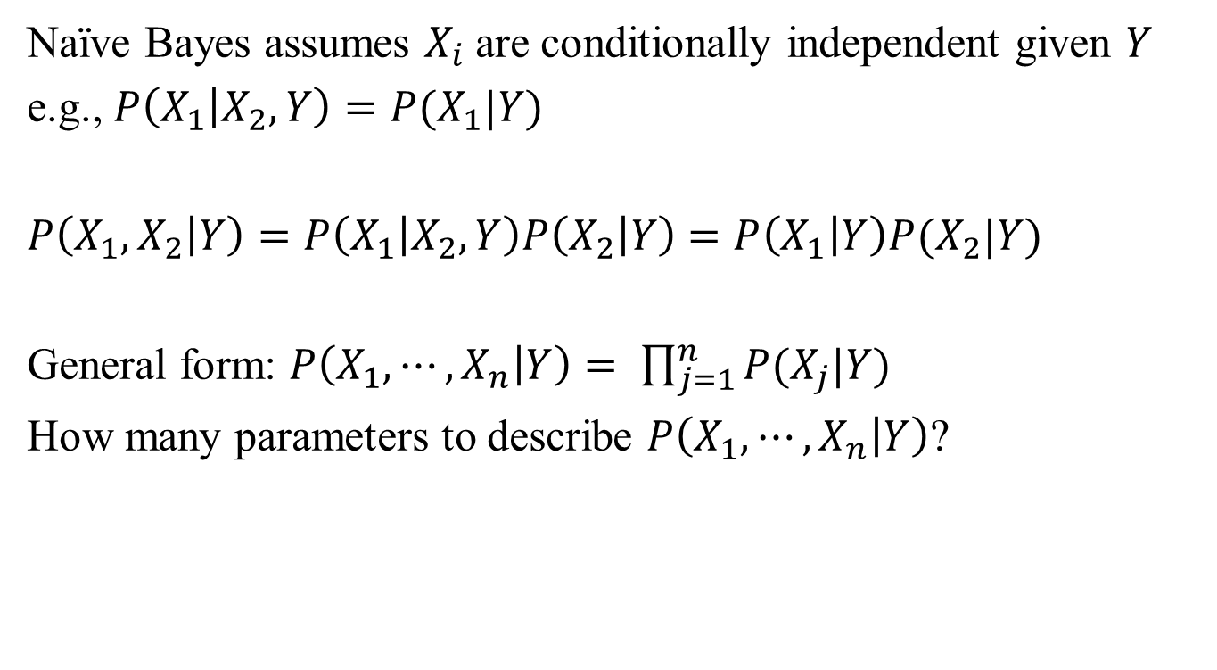
Applying conditional independence
Naïve Bayes assumes $X_{i}$are conditionally independent given $Y$
e.g., $P\left(X_{1} | X_{2}, Y\right)=P(X_{1}|Y)$
$P\left(X_{1}, X_{2} | Y\right)=P\left(X_{1} | X_{2},Y\right)P\left(X_{2} | Y\right)$ $=P\left(X_{1} | Y\right)P(X_{2}|Y)$
General form: $P\left(X_{1}, ⋯,X_{n} | Y\right)= \prod_{j=1}^{n}{P(X_{j}|Y)}$
How many parameters to describe $P\left(X_{1}, ⋯,X_{n} | Y\right)$?

Slide 36

Naïve Bayes Independence assumption
Assumption:
$$P\left(X_{1}, ⋯,X_{n} | Y\right)= \prod_{j=1}^{n}{P(X_{j}|Y)}$$
i.e., $X_{i}$ and $X_{j}$ are conditionally independent given $Y$ for $i≠j$

Slide 37
Naïve Bayes Classifier
Assume independence among attributes X_{i} when class is given:
P(X₁, X₂, …, X_{d} |Y_{j}) = P(X₁| Y_{j}) P(X₂| Y_{j})… P(X_{d}| Y_{j})
Now we can estimate P(X_{i}| Y_{j}) for all X_{i} and Y_{j} combinations from the training data
New point is classified to Y_{j} if P(Y_{j}) Π P(X_{i}| Y_{j}) is maximal.
Slide adopted from “Introduction to Data mining” Vipin Kumar

Slide 38
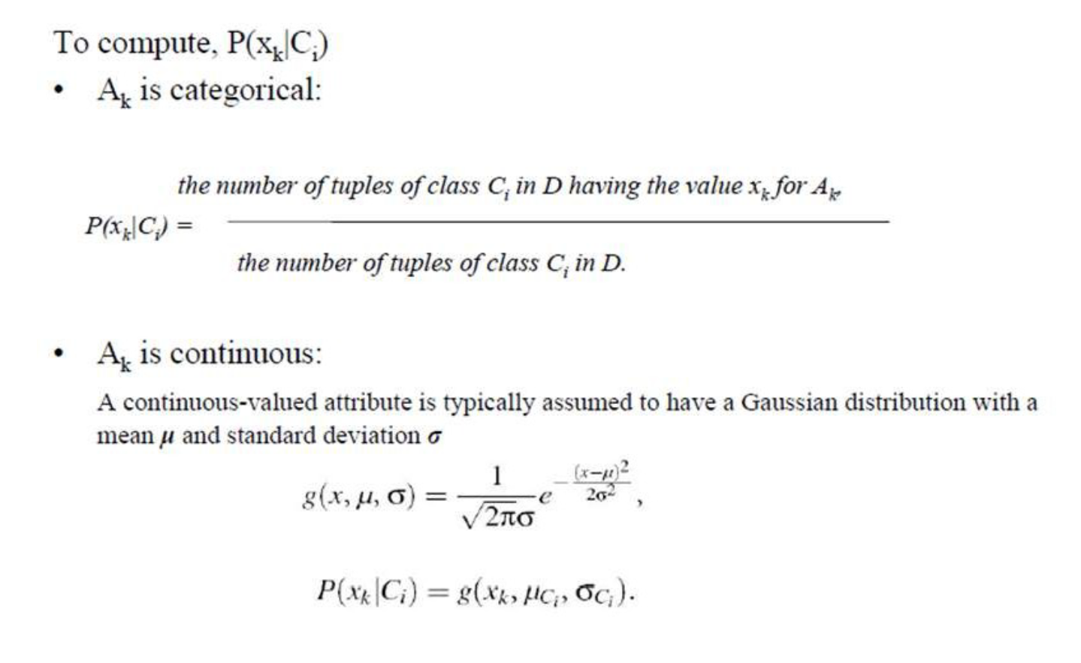
Class Conditional Probabilities

Slide 39

How to Estimate Probabilities from Data?
Class: P(C) = N_{c}/N
e.g., P(No) = 7/10, P(Yes) = 3/10
For discrete attributes: P(A_{i} | C_{k}) = |A_{ik}|/ N_{ck}
where |A_{ik}| is number of instances having attribute A_{i} and belongs to class C_{k}
Examples:
P(Status=Married|No) = 4/7 P(Refund=Yes|Yes)=0
Tid | Refund | Marital Status | Taxable Income | Evade
1 | Yes | Single | 125 | No
2 | No | Married | 100 | No
3 | No | Single | 70 | No
4 | Yes | Married | 120 | No
5 | No | Divorced | 95 | Yes
6 | No | Married | 60 | No
7 | Yes | Divorced | 220 | No
8 | No | Single | 85 | Yes
9 | No | Married | 75 | No
10 | No | Single | 90 | Yes

Slide 40
How to Estimate Probabilities from Data?
For continuous attributes:
Discretize the range into bins
one ordinal attribute per bin
Too many bins – training records are too few to provide reliable probability for each interval
Too few bins – some intervals may aggregate from different classes & we may miss the correct decision boundary
Probability density estimation:
Assume attribute follows a normal distribution
Use data to estimate parameters of distribution (e.g., mean and standard deviation)
Once probability distribution is known, can use it to estimate the conditional probability P(A_{i}|C_{k})

Slide 41

How to Estimate Probabilities from Data?
Tid | Refund | Marital Status | Taxable Income | Evade
1 | Yes | Single | 125K | No
2 | No | Married | 100K | No
3 | No | Single | 70K | No
4 | Yes | Married | 120K | No
5 | No | Divorced | 95K | Yes
6 | No | Married | 60K | No
7 | Yes | Divorced | 220K | No
8 | No | Single | 85K | Yes
9 | No | Married | 75K | No
10 | No | Single | 90K | Yes
Normal distribution:
One for each (A_{i},c_{i}) pair
For (Income, Class=No):
If Class=No
sample mean = 110
sample variance = 2975

Slide 42
Example of Naïve Bayes Classifier
Given a Test Record:
Tid | Refund | Marital Status | Taxable Income | Evade
1 | Yes | Single | 125K | No
2 | No | Married | 100K | No
3 | No | Single | 70K | No
4 | Yes | Married | 120K | No
5 | No | Divorced | 95K | Yes
6 | No | Married | 60K | No
7 | Yes | Divorced | 220K | No
8 | No | Single | 85K | Yes
9 | No | Married | 75K | No
10 | No | Single | 90K | Yes
P(X|Class=No) = P(Refund=No|Class=No) × P(Married| Class=No) × P(Income=120K| Class=No) = 4/7 × 4/7 × 0.0069 = 0.0023
P(X|Class=Yes) = P(Refund=No| Class=Yes) × P(Married| Class=Yes) × P(Income=120K| Class=Yes) = 1 × 0 × 1.2 × 10⁻⁹ = 0
Since P(X|No)P(No) > P(X|Yes)P(Yes)
Therefore P(No|X) > P(Yes|X) => Class = No

Slide 43
Naive Bayes Classifier
If one of the conditional probability is zero, then the entire expression becomes zero
Probability estimation is done with Laplacian correction:
C: No. of distinct values of an attribute

Slide 44
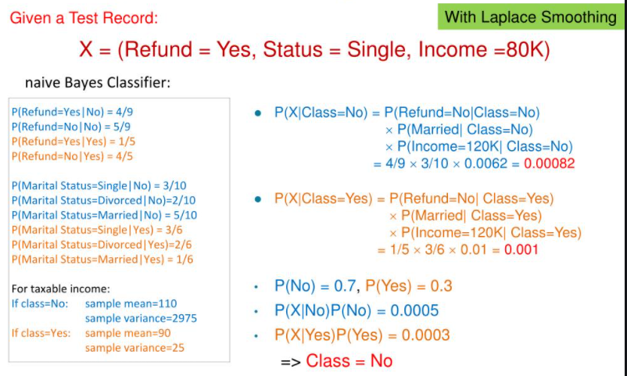
Example of Naïve Bayes Classifier
Tid | Refund | Marital Status | Taxable Income | Evade
1 | Yes | Single | 125K | No
2 | No | Married | 100K | No
3 | No | Single | 70K | No
4 | Yes | Married | 120K | No
5 | No | Divorced | 95K | Yes
6 | No | Married | 60K | No
7 | Yes | Divorced | 220K | No
8 | No | Single | 85K | Yes
9 | No | Married | 75K | No
10 | No | Single | 90K | Yes

Slide 45
Example
You are working in google.com where people disclose their salary information. As part of profile creation, the firm captures various important details about its members. Some of the samples are shown in the below table. Using this sample dataset, with the help of Bayesian classification technique, classify the following tuple either as “High”, or “Middle” or “Low” income bracket member.
{SrNo = “7”, Age = “Above_40”, Gender = “M”, Occupation = “Software Engineer”}
Sr No | Age | Gender | Occupation | Income Bracket
1 | Above_40 | F | Software Engineer | High
2 | Below_30 | M | Marketing Executive | Middle
3 | Between_31_to_40 | M | Unemployed | Low
4 | Below_30 | M | Data Scientist | High
5 | Between_31_to_40 | F | Software Engineer | High
6 | Below_30 | F | Unemployed | Low

Slide 46
Naïve Bayes Generative Model
Naïve Bayes classifier uses likelihood and prior probability to calculate conditional probability of the class
Likelihood is based on joint probability, which is the core principle of probabilistic generative model
Naïve Bayes simplifies the calculation of likelihood by the assumption of conditional independence among input parameters
Each parameter’s likelihood is determined using joint probability of the input parameter and the output label

Slide 47
Naïve Bayes – When to use
When the training data is small
When the features are conditionally independent (mostly)
When we have a fewer missing data
When we have large number of features with minimal data set
Ex: Text classification

Slide 48
Gaussian Naïve Bayes Algorithm
A Gaussian Naive Bayes algorithm is a special type of NB algorithm.
It’s specifically used when the features have continuous values.
It’s also assumed that all the features are following a Gaussian distribution i.e, normal distribution.

Slide 49
MultinomialNB
https://www.sicara.ai/blog/2018-02-28-naive-bayes-classification-sklearn

Slide 50
Extra Reading
Text Classification in NLP using Naïve Bayes
https://medium.com/@theflyingmantis/text-classification-in-nlp-naive-bayes-a606bf419f8c
More on Probability
https://www.probabilitycourse.com/chapter1/1_0_0_introduction.php

Slide 51
References
https://towardsdatascience.com/probability-concepts-explained-bayesian-inference-for-parameter-estimation-90e8930e5348
https://towardsdatascience.com/probability-concepts-explained-introduction-a7c0316de465
https://medium.com/@theflyingmantis/text-classification-in-nlp-naive-bayes-a606bf419f8c
https://www.youtube.com/watch?v=5Pck0Cqw-zc
https://towardsdatascience.com/basic-probability-theory-and-statistics-3105ab637213
https://nlp.stanford.edu/IR-book/html/htmledition/properties-of-naive-bayes-1.html

Slide 52
Thank You

